Slide 1
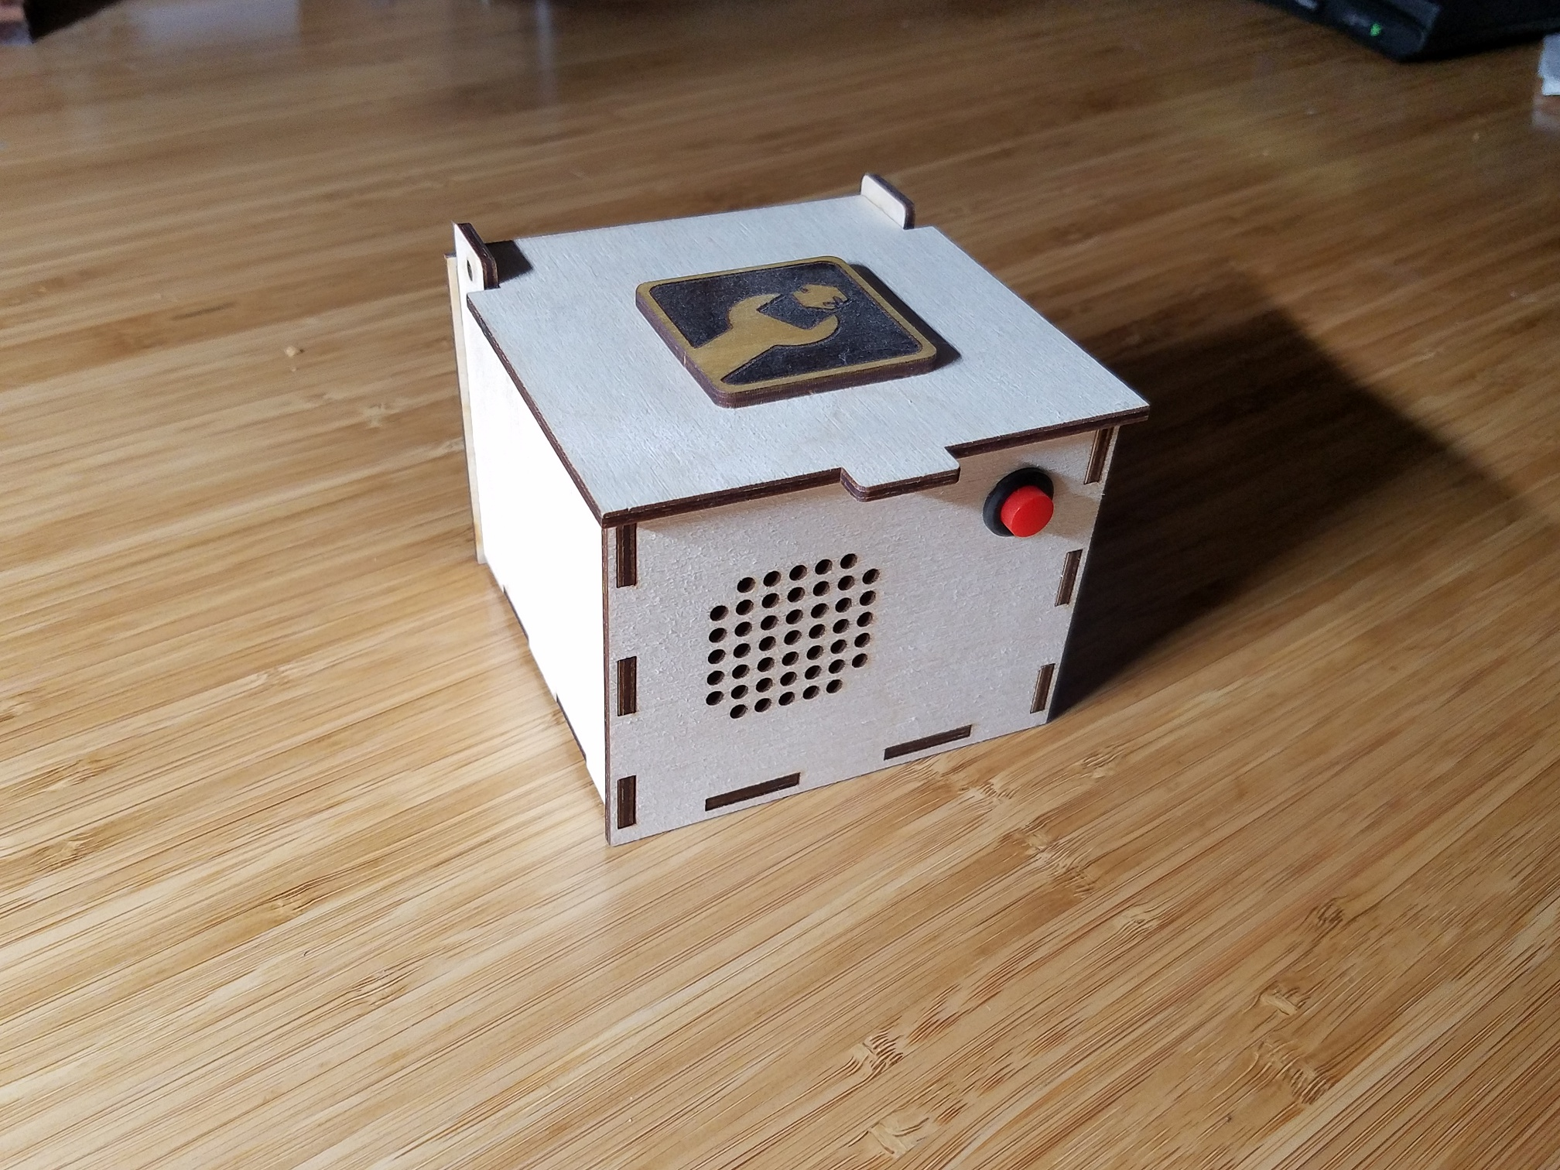
Intro to Arduino: Build a Digital Music Box

Slide 2
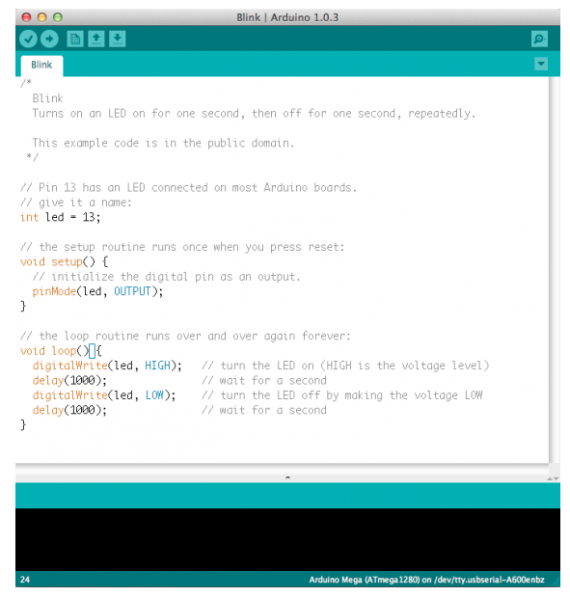
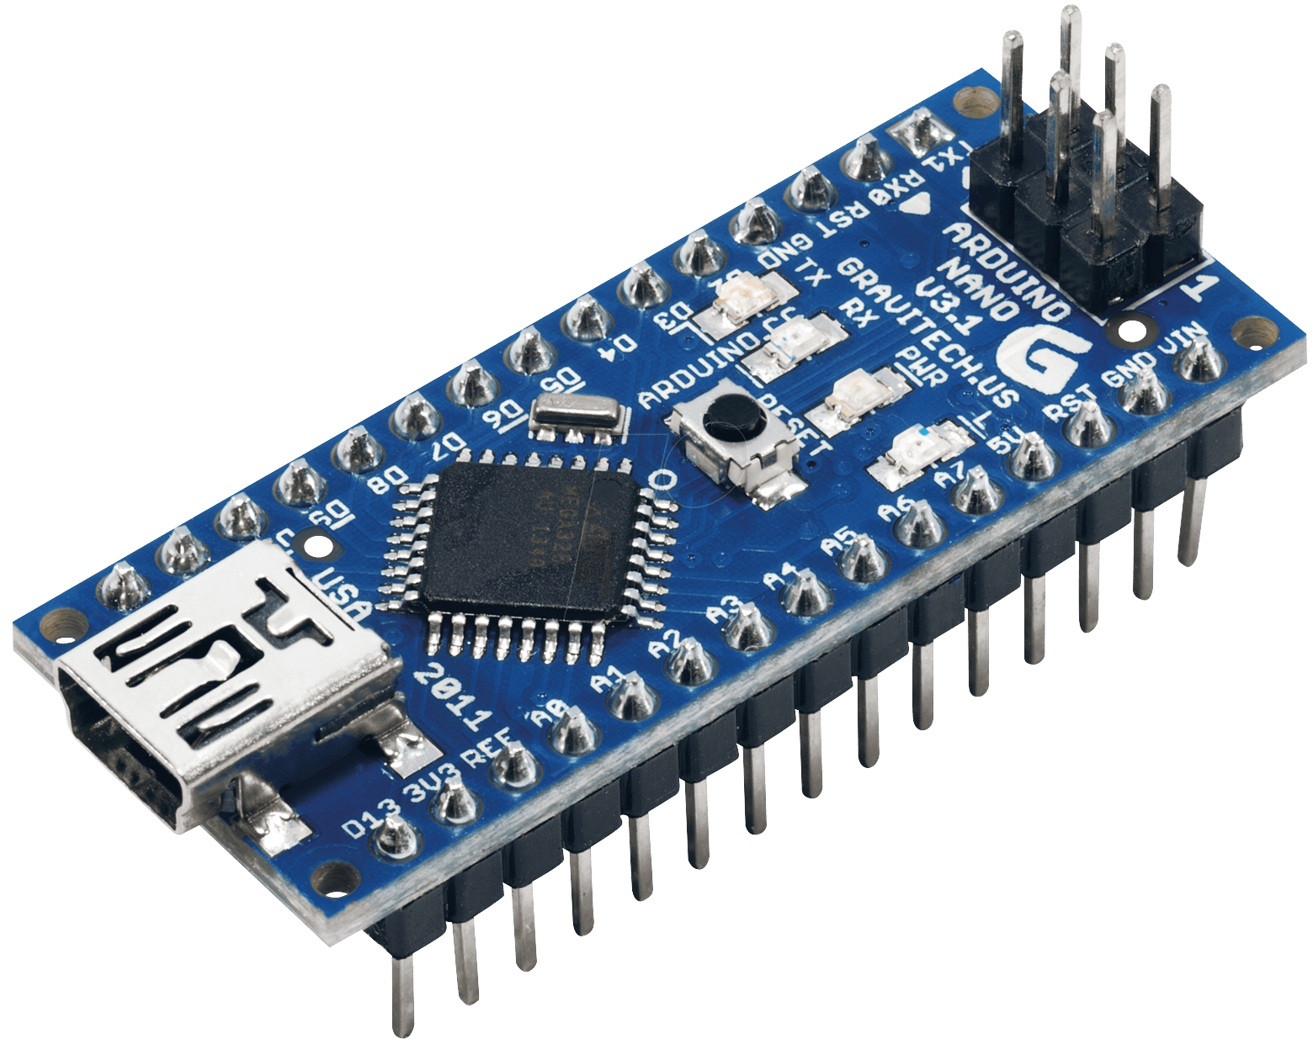
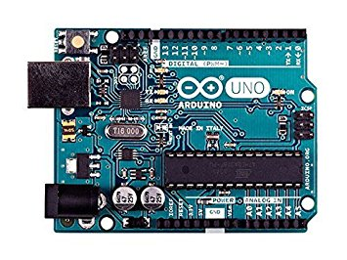
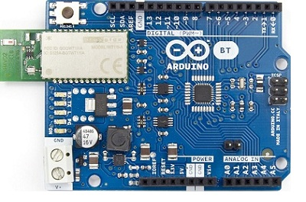
What is an Arduino?
Open Source Hardware & Software
Arduino boards
Arduino IDE and Libraries
BT

Slide 3
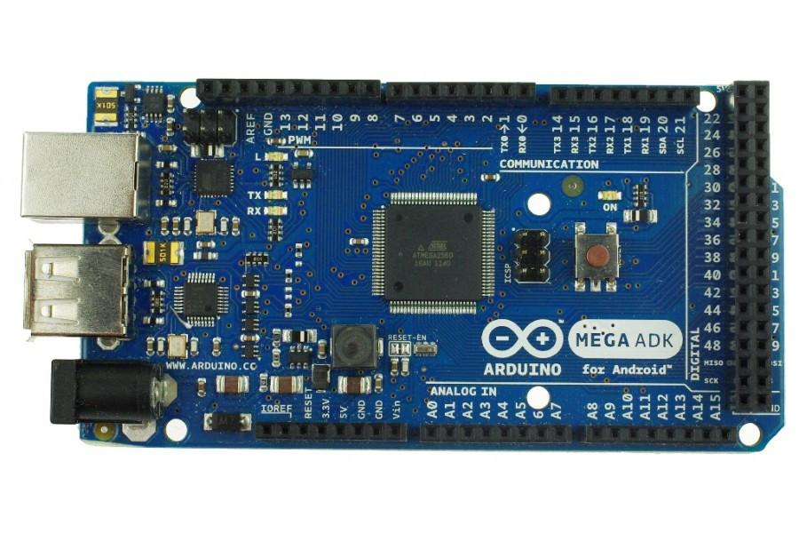
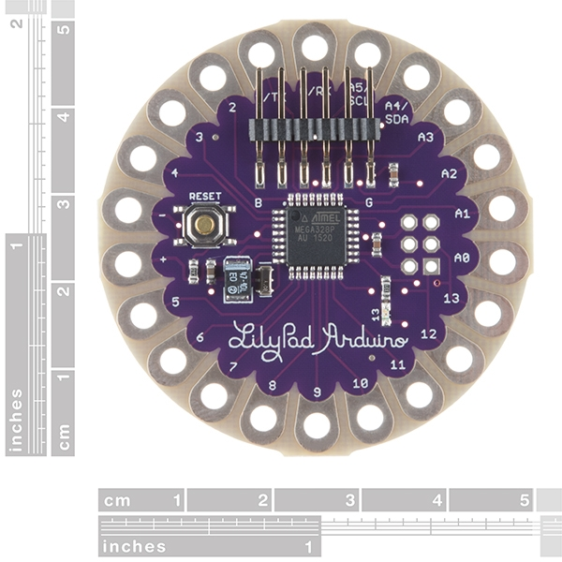
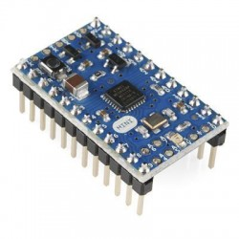
There is a wide variety of Arduino Boards
Uno
Mega
Lilypad
BT
BT
Nano
Pro Mini

Slide 4
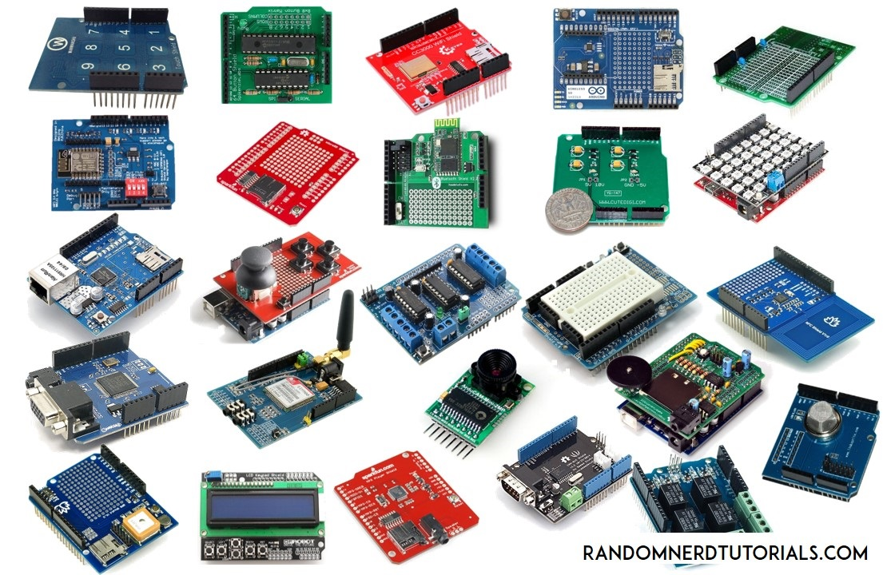
Accessory “shields”
BT

Slide 5
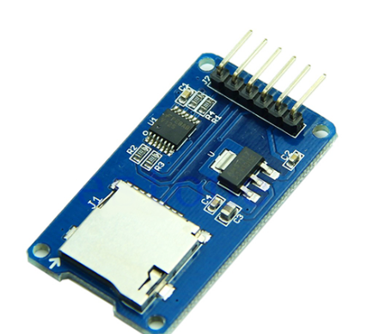
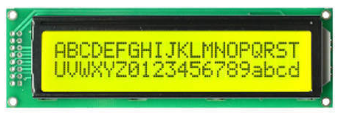
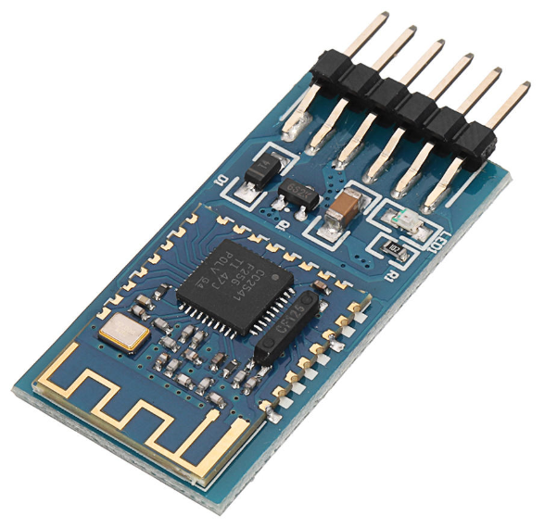
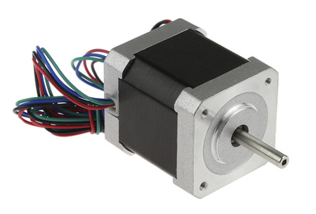
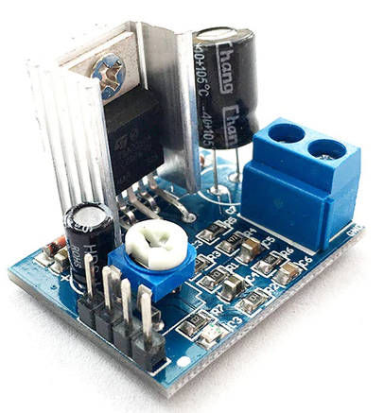
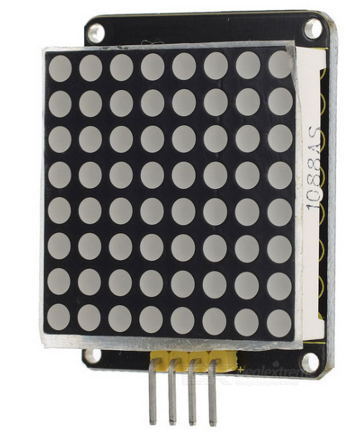
There is a wide range of free libraries
BT

Slide 6
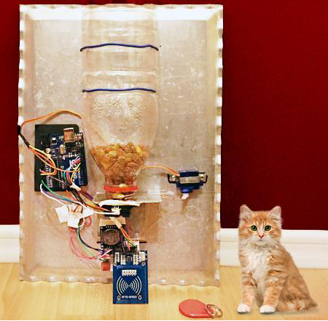
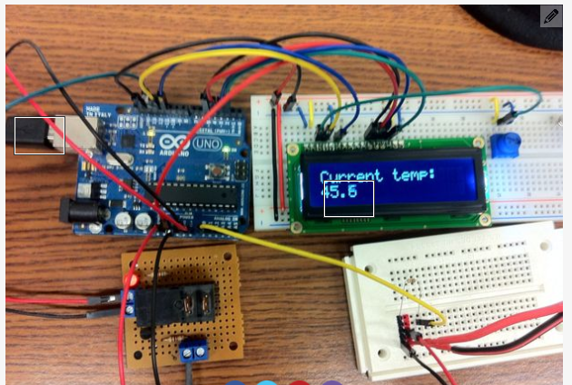
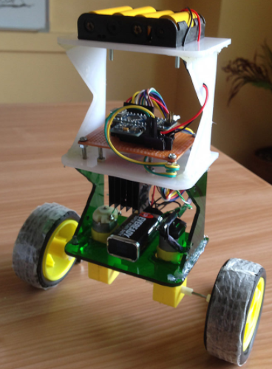
What can we do with an Arduino?
An Arduino is a general purpose tool that simply executes whatever instructions you give it
Pet Feeder
Sous Vide Cooker
At 8am and 5pm send a signal to the motor so it rotates and dispenses food
Self-Balancing Robot
If the temperature is too low, turn the heater on
If the temperature is too high, turn the heater off
BT
If leaning forward spin motors forward
If leaning backwards, spin motors backwards

Slide 7
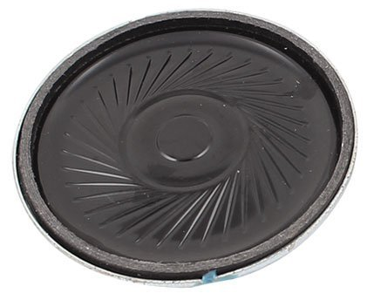
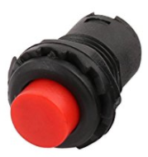
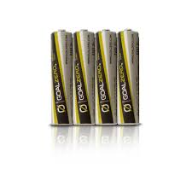
What are we building today?
Arduino Nano
(The Brain)
Switch
(To Control It)
Speaker
Batteries
(Power Source)

Slide 8
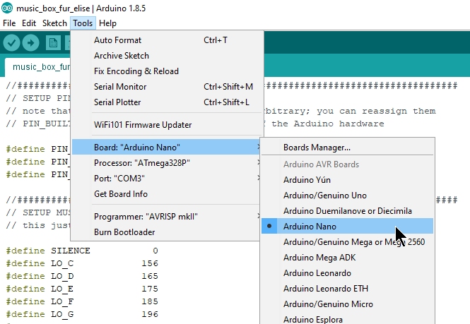
Start the IDE, Configure the Board and Processor
Set the board type:
Tools->Board->Arduino Nano
Set the processor type:
Tools->Processor->ATmega328P (Old Bootloader)
This refers to the Arduino board that we are using

Slide 9
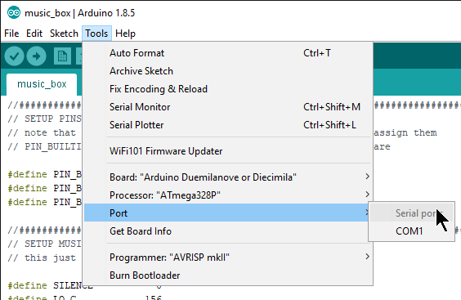

Configure the IDE – Select the correct port
Set the port:
Tools->Port->[this depends on your system]
This is the (typically USB) port on your computer that will be used to send data from the computer to the Arduino
You often have to figure out which one is correct through trial and error

Slide 10
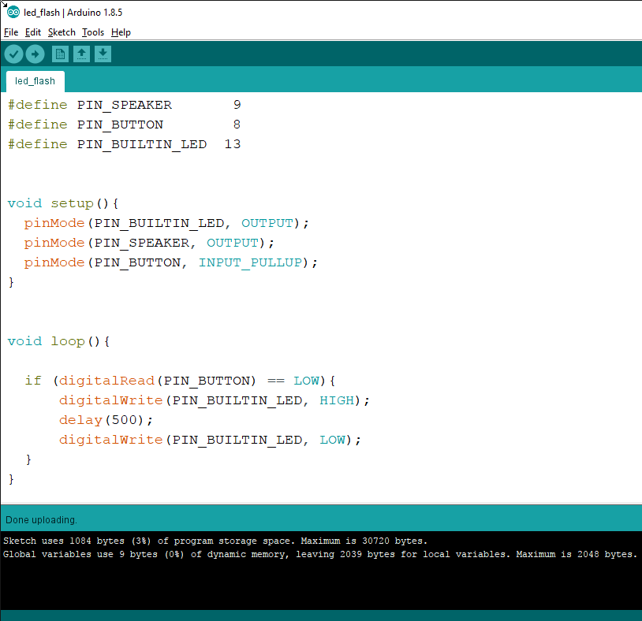
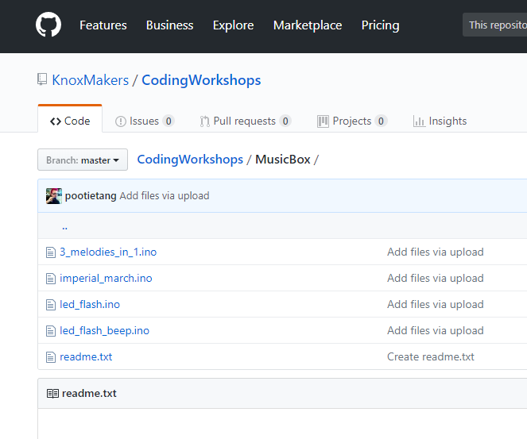
Download the led_flash sketch and upload to your Arduino
Download “led_flash.ino” from KM github
Web search “knox makers git hub”
https://github.com/KnoxMakers/CodingWorkshops/tree/master/MusicBox
Upload to Arduino using the upload button:
Look for the “Done uploading” (or errors) in the status bar

Slide 11
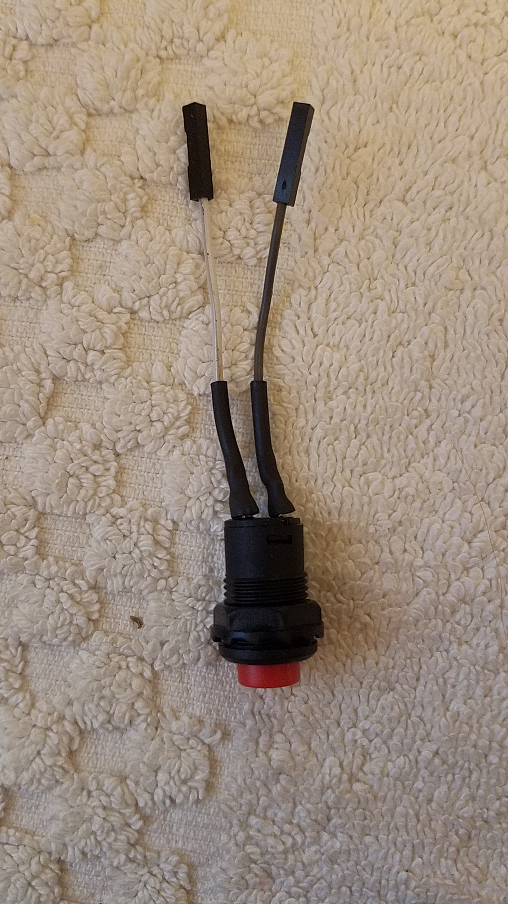
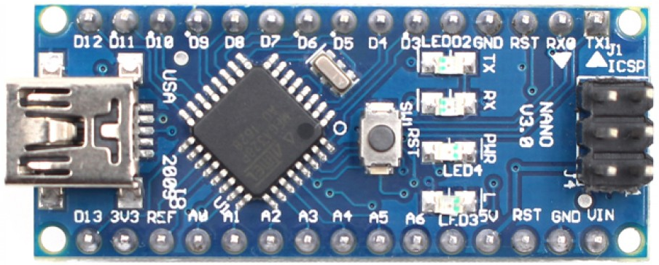
Connect the Pushbutton to your Arduino and press it!
One wire goes to GND, one wire goes to D8
5th pin from left
4th pin from right

Slide 12
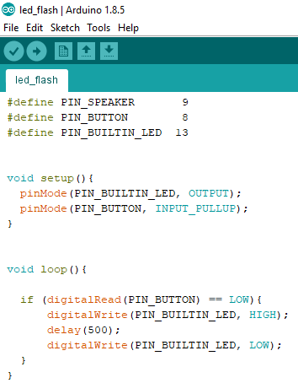
The led_flash sketch explained
This sketch is broadly organized into 3 sections
Definitions: which pins are used for what
This makes the code below easier to read
Setup() – function is run one time, each time the Arduino is powered up
Used to set pins as inputs or outputs
loop() – function is run over and over as long as the Arduino is powered up
Logic that determines what to do when button is pressed

Slide 13
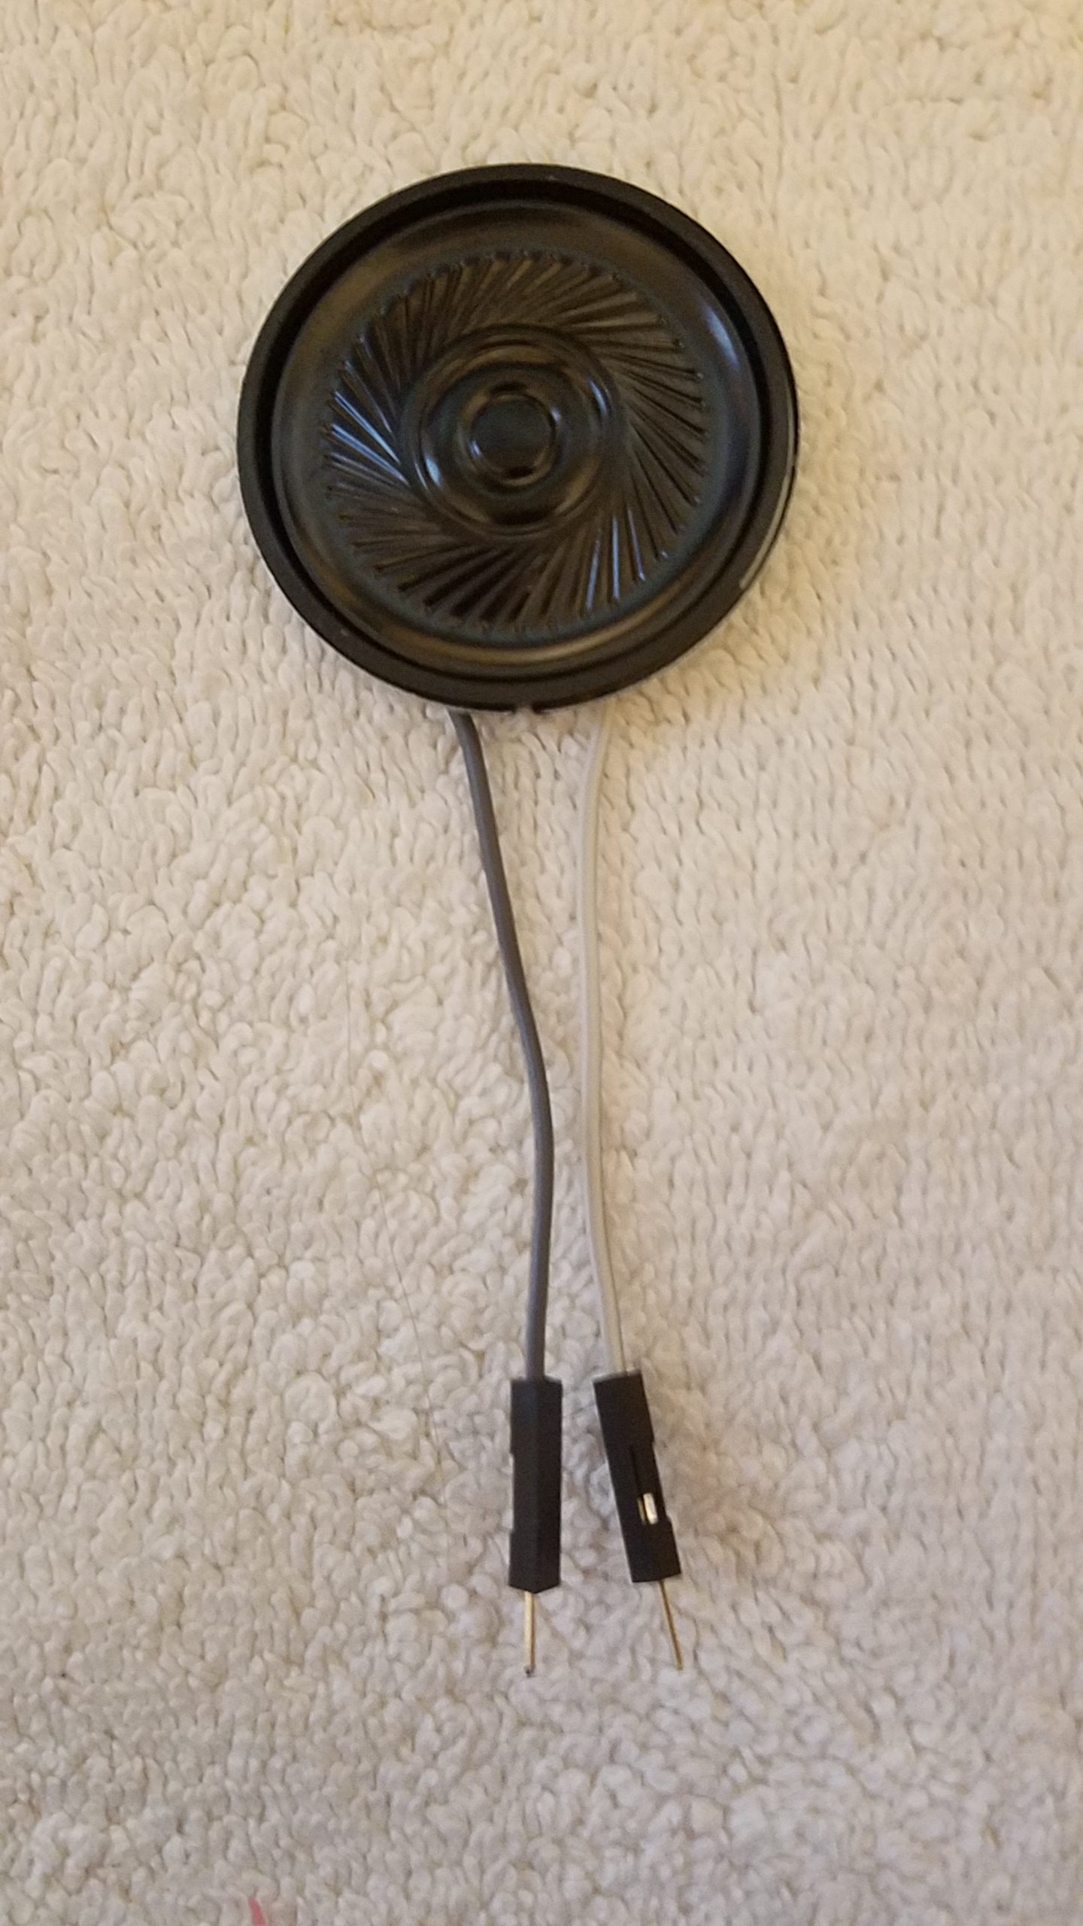
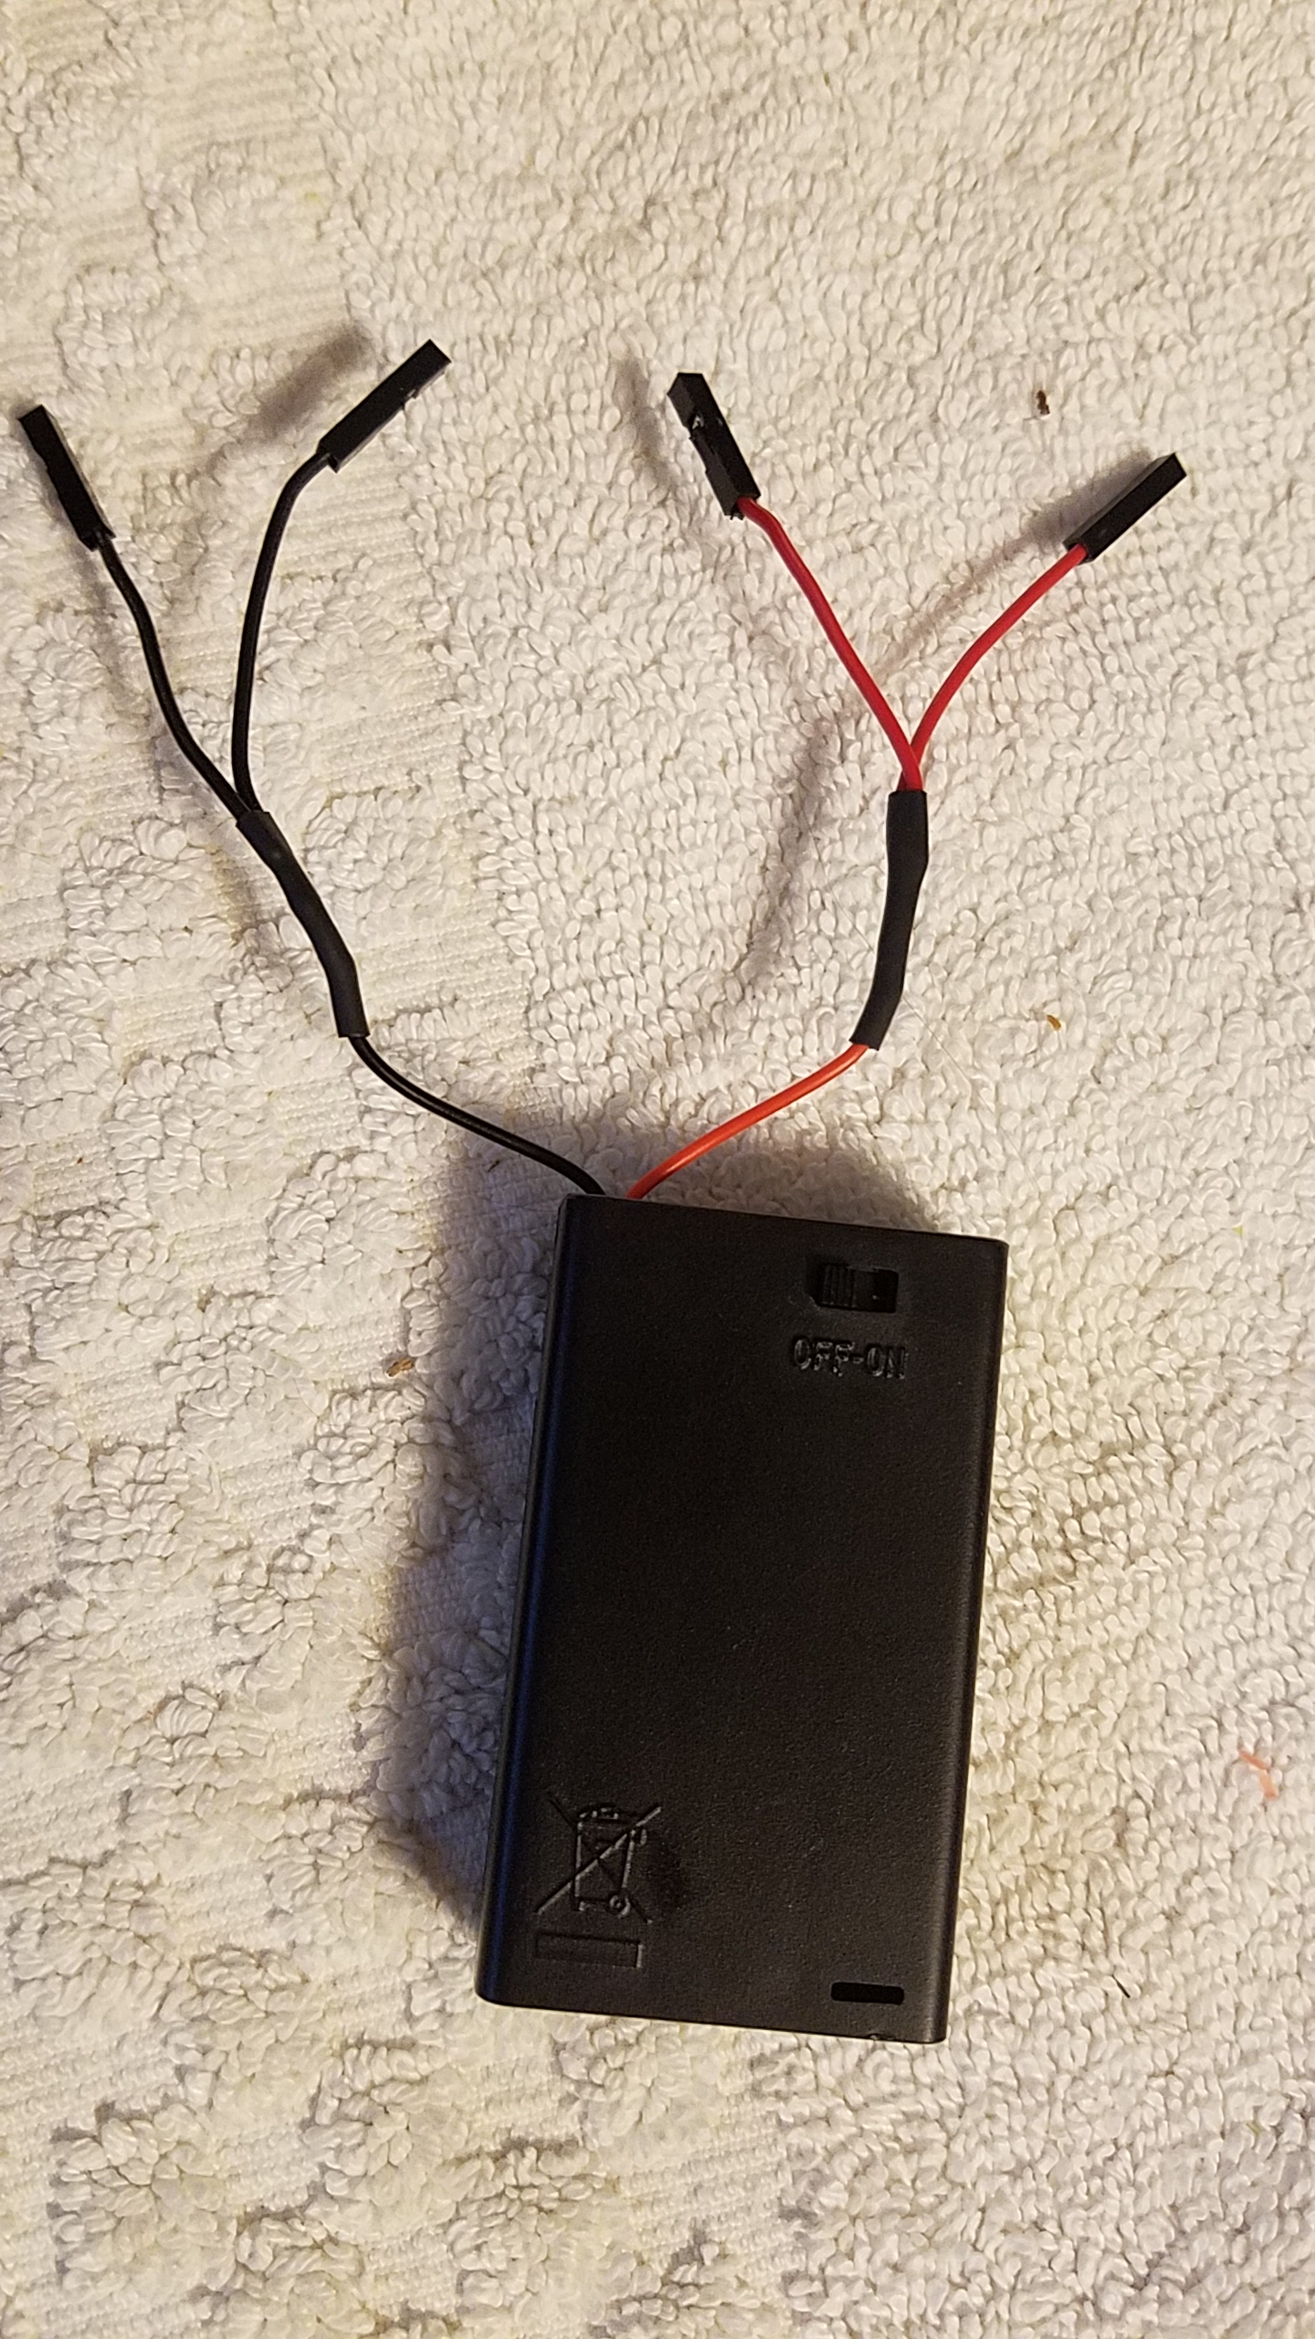
Let’s hook up the rest of the circuit
one wire to GND
the other to D9
2nd pin from right
Red lead -> “5V”
Black lead -> ICSP GND

Slide 14
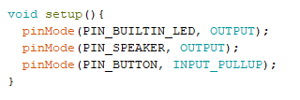
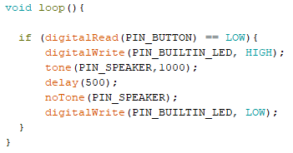
Now modify the code to make it play a tone when you press the button
Add this line to the setup() function
Add these two lines to the code
Upload the sketch
Try it out!

Slide 15
Now download any of these and try them out
Web search “knox makers git hub”
https://github.com/KnoxMakers/CodingWorkshops/tree/master/MusicBox
jingle_bells.ino
fur_elise.ino
imperial_march.ino

Slide 16
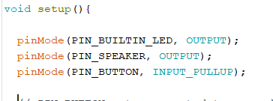
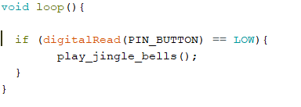
Let’s look at jingle_bells.ino
No change, defines our three pins
Repeatedly checks if the button is pressed. If so, play jingle bells

Slide 17
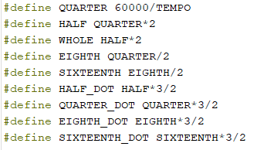
Definition of Song Tempo and Note Duration

Slide 18
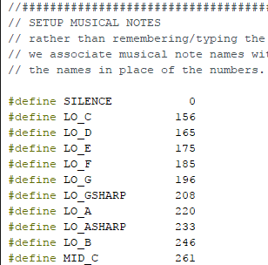
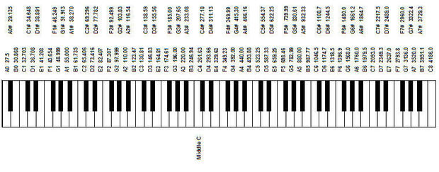
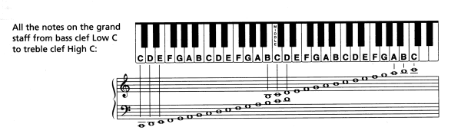
Table of musical notes

Slide 19
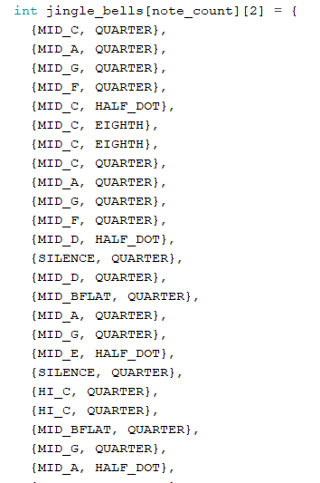
Definition of the song itself
Each row consists of one note (frequency and duration)
Further reading:
arrays and matrices in C

Slide 20
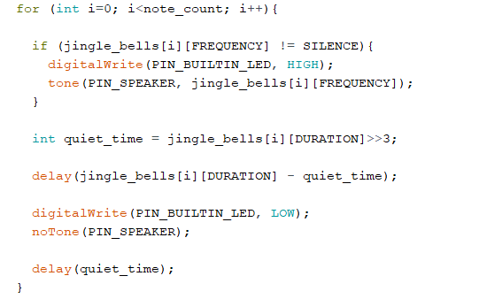
The playJingleBells() loop – play the notes
Loop through the matrix of notes
If this is a note Turn LED on
Play tone on speaker
Delay for a bit while the tone plays
Turn off LED and tone

Slide 21
Finish it off
Put everything into the laser cut box
Hot glue the speaker behind the grill
Put the switch in the precut hole
Put a small bit of Velcro on the battery box and the laser cut box to affix it in place
Place everything else however you’d like
The solder connections to the speaker are a weak point so affixing the audio amp with a little Velcro would be a good idea
What next?
Have it play the melody twice
Require 2 button presses to play it one time
Change which pins are used on the PC board
Write your own melody

Slide 22
Appendix

Slide 23
INPUT_PULLUP explained
When Arduino pins are configured as inputs they can also be configured to have internal pull-up resistors enabled
These resistors provide a gentle pull-up to the Vcc of the device
When the switch is pressed, it pulls the pin to ground much more strongly than the pull-up pulls to Vcc.
Arduinos also have a pull-down option
5V
Logic
D8

Slide 24
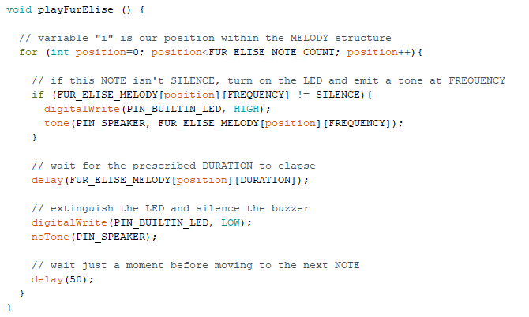
The playFurElise() portion is new, and a bit complicated
All this function does is go through the matrix of notes we looked at earlier, play them in sequence and blink the LED
Iterate through the matrix of notes
- matrices start at 0 (not 1)
Turn the LED on and off
tone() and noTone() play the notes
delay() lets the note play for the required duration

